Slide 1
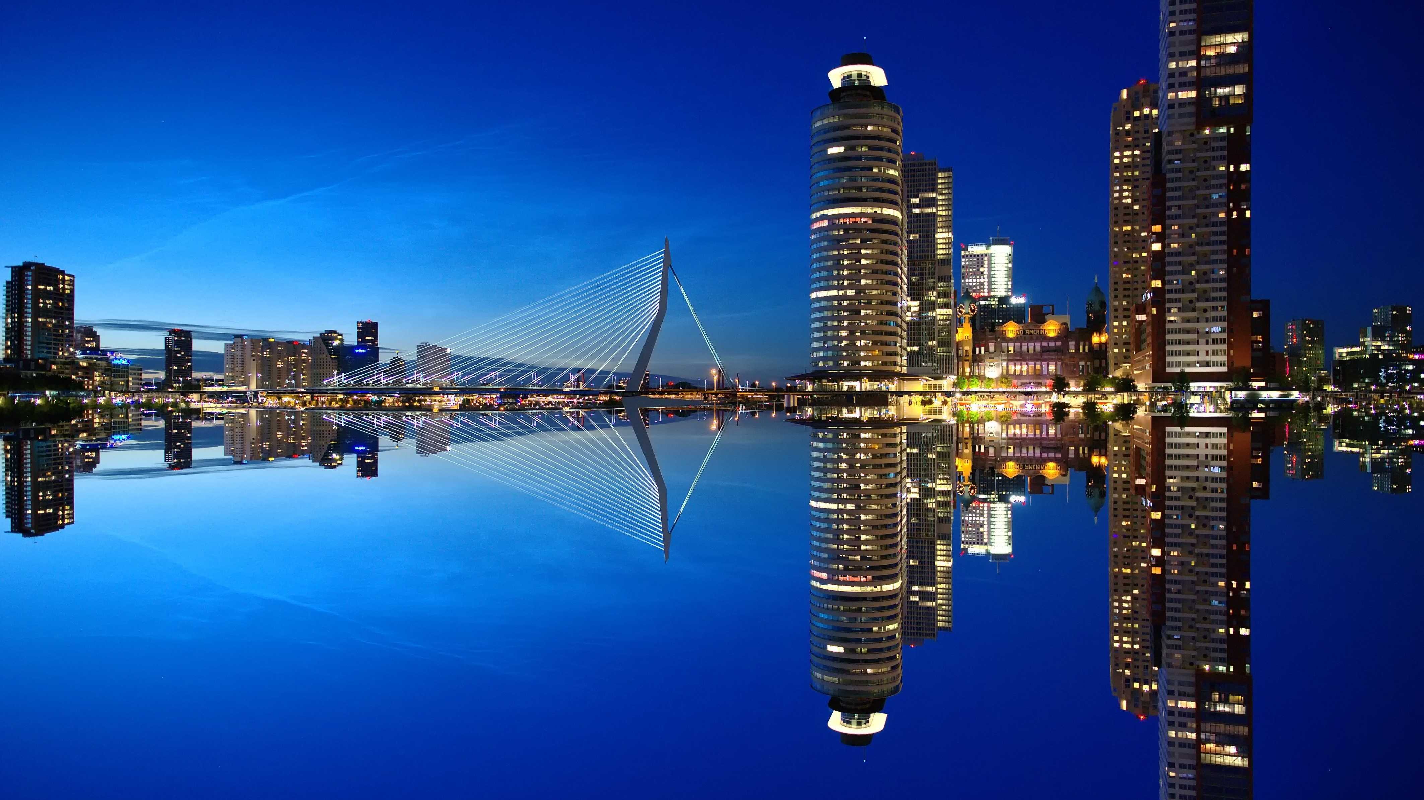
CEOCOR 2026 sponsoring package
2 - 5 June 2026
Rotterdam - The Netherlands

Slide 2

Interested in becoming a sponsor?
  As a sponsor of CEOCOR 2026, you’ll put your organization in the spotlight before an international audience of experts, decision-makers, and innovators.
  Your brand will gain visibility in a setting where knowledge, networking, and innovation converge.
  Choose from one of the various sponsorship packages and make an impact with your contribution.

Slide 3
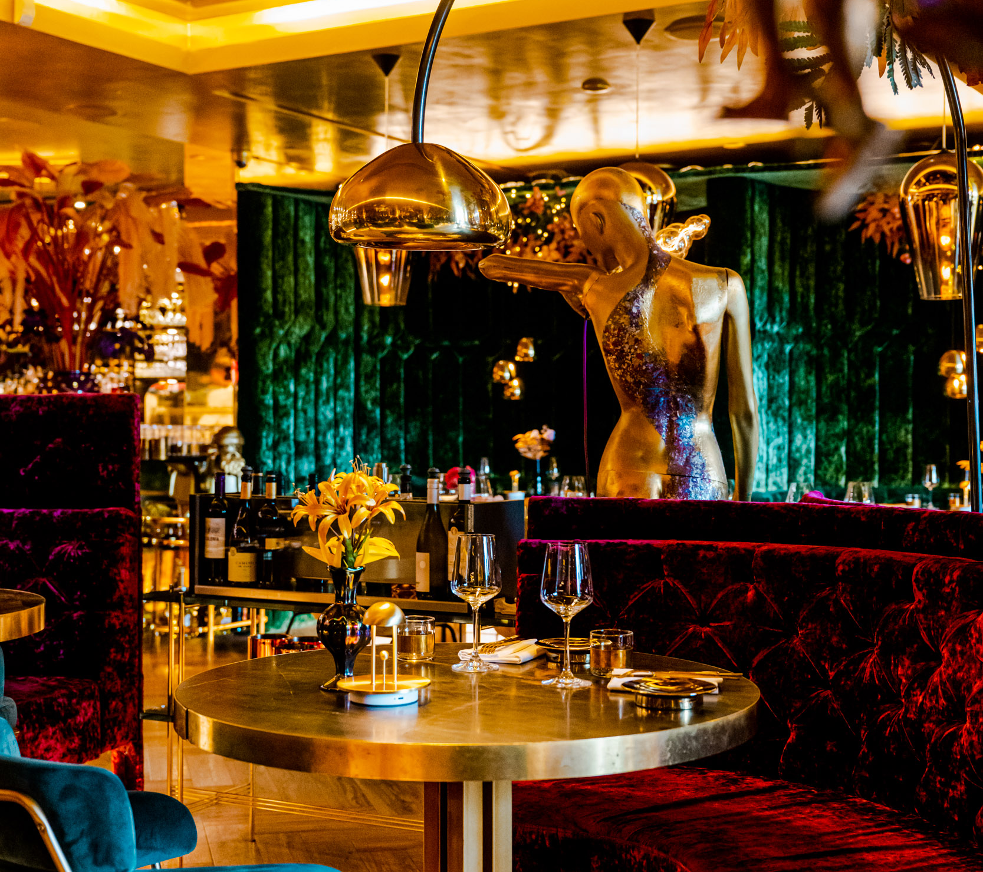
Gold Sponsorship package
  Sponsorship of the dinner at restaurant Goud (Thursday 4 June).
  Goud - The Place to Be
  Goud is de renowned restaurant in Rotterdam where chefs Nick de Kousemaker and Herman den Blijker love to surprise you. Using fresh, seasonal and locally sourced ingredients, they create the most exquisite culinary dishes.
  Rotterdam chic, with just that touch of flair.

Slide 4
Gold Package Includes:
Recognition as main event sponsor
Company logo with link to own website on event website
Company logo in printed program
Company logo displayed on screen during breaks
Roll up banner at restaurant entrance
Free brochure inclusion in the event shopper
Free marketing material inclusion in the event shopper
Two confermence tickets (excluding accommodation)
Exhibition stand
€ 10.000

Slide 5
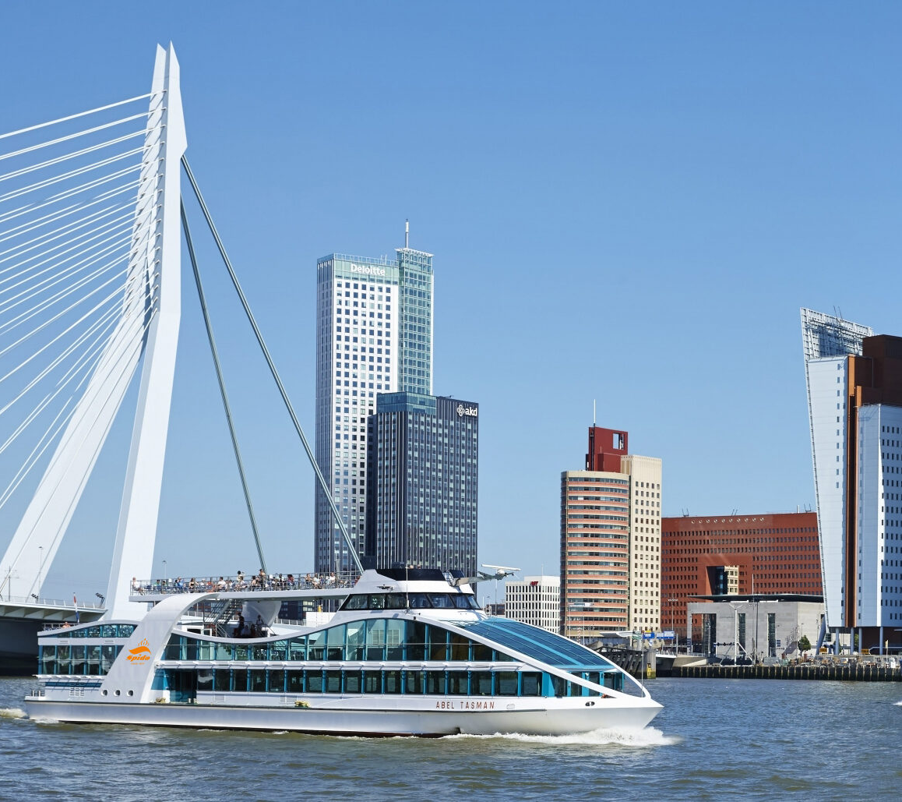
Sponsorship Package
Cruise & Connect
  Sponsorship of the cruise through the ports of Rotterdam (Thursday 4 June).
  A special boat trip on the Maas and through the ports of Rotterdam. A unique view of wharves, docks and container transshipment. And of course the spectaculair view at the the one and only skyline in the Netherlands.

Slide 6
Package Cruise & Connect
Company logo with link to own website on event website
Company logo on printed program
Company logo on screen during breaks
Free addition of brochure in event shopper
Free addition of marketing material to event shopper
One admission ticket for the conference (excl. overnight stay)
€ 6.000

Slide 7
Cruise & connect package plus
+
Additional benefits included in the Cruise & Connect package:
Recognition as main sponsor of the event
Company logo displayed on screen during breaks
Roll-up banner
One extra conference admission ticket (excluding overnight stay)
Optional: exhibition stand
€ 10.000

Slide 8
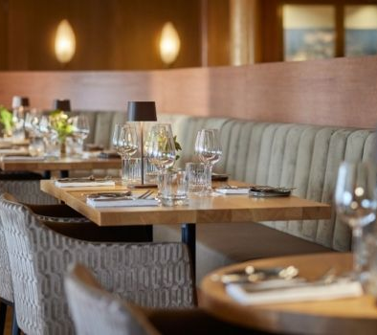
Captain's Diner
Sponsorship Package
  Sponsorship of the dinner on board the SS Rotterdam (Wednesday, June 2).
  On board the SS Rotterdam, we bring together participants and partners for an atmospheric dinner - an evening full of connection, hospitality, and international encounters.
  This sponsorship package offers a unique opportunity to be visible in a special setting and contribute to an unforgettable conference experience.

Slide 9
Package Captain's diner
Company logo with link to your own website on event website
Company logo in the printed program
Company logo displayed on screen during breaks
Free inclusion of brochure in event shopper
Free inclusion of marketing materials in the event shopper
One conference admission ticket (excluding overnight stay)
€ 6.000

Slide 10
Package Captain's diner plus
+
Additional benefits included in the Captain’s diner package:
Recognition as the main sponsor of the event
Company logo displayed on screen during breaks
Roll-up banner
One extra conference ticket (excluding overnight stay)
Exhibition stand option
€ 10.000

Slide 11
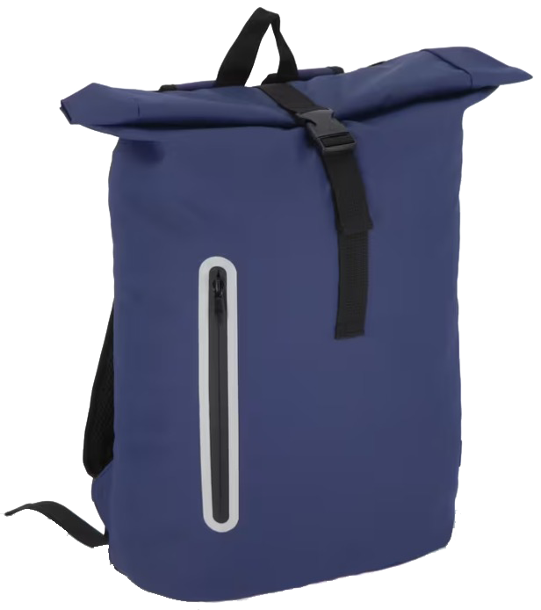
Sponsorship package
Eventshopper
  The event shopper is a sturdy backpack made from recycled materials, featuring your logo.
  It will be filled with marketing materials from the sponsors and exhibitors of the conference.

Slide 12
Package Event Shopper
Company logo printed on the bag (1 color)
Company logo with link to your website on event website
Free inclusion of brochure in event shopper
Free inclusion of marketing materials in the event shopper
One conference admission ticket (excluding overnight stay)
€ 5.000

Slide 13

Cheers Sponsorship
Package
  Cheers sponsorship- Network Reception (Tuesday, June 2)
  After an afternoon filled with knowledge, presentations and technical insights, it is time to unwind. The networking reception offers a unique opportunity to be visible during an informal moment of the conference.
  direct access to an international network of professionals
  show that your organization invests in connection and innovation

Slide 14
Cheers Package
Company logo with link to your website on event website
Free inclusion of brochure in the event shopper
Free inclusion marketing material in the event shopper
€ 1.000

Slide 15
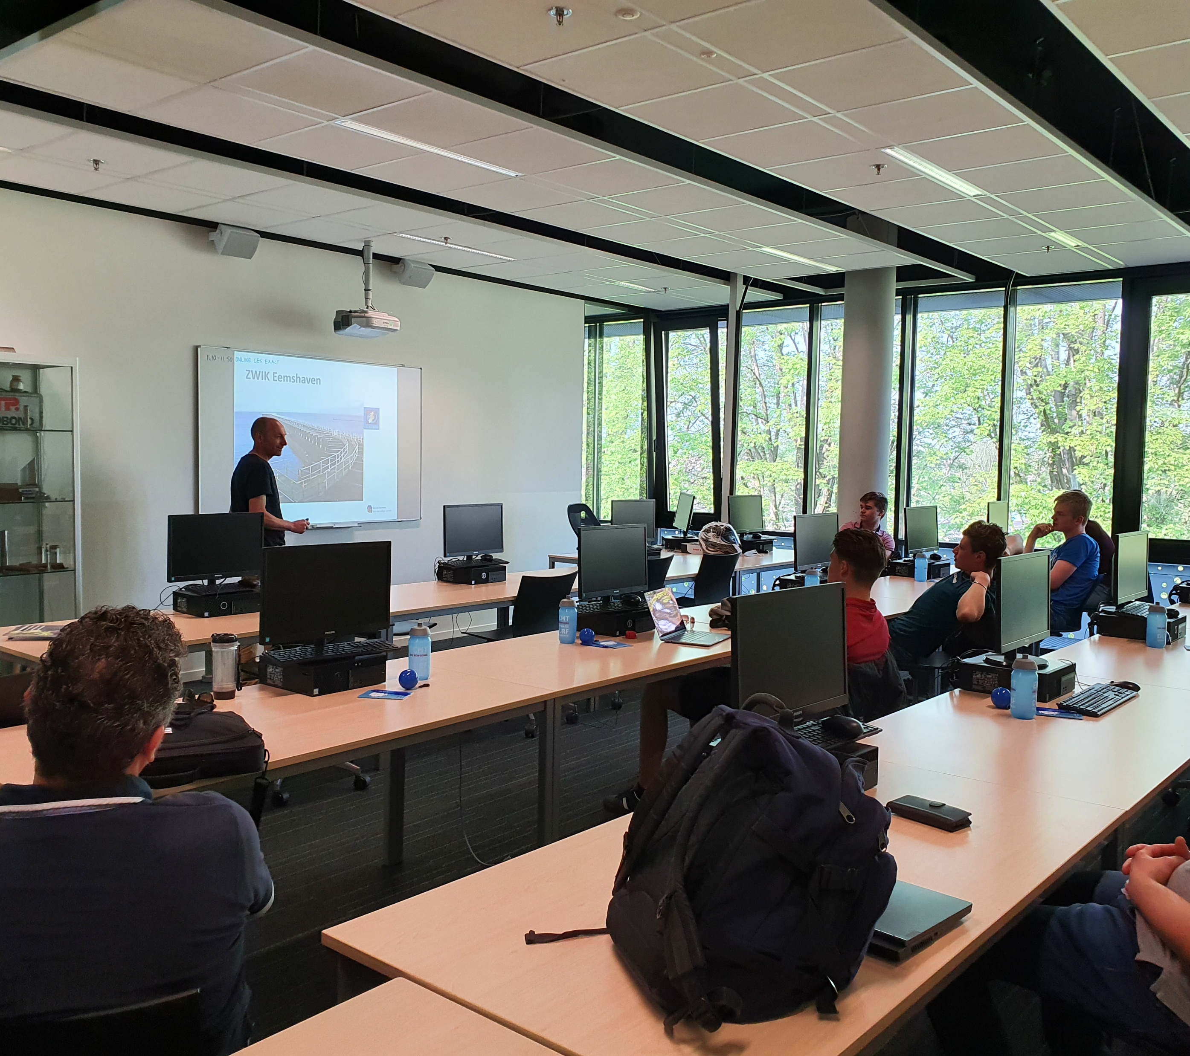
KB for Dummies
Sponsorship Package
  New! A unique feature of this CeoCor conference is the “KB for Dummies” session - an inspiring and informative program designed for university students.
  During an interactive morning, students will be introduced to the world of cathodic protection, with several speakers sharing their insights.
  After the session, students will have the opportunity to network during a joint lunch with other conference participants.

Slide 16
KB for Dummies
Sponsorship Package
Company logo with link to your website on the event website
Free inclusion of brochure in the event shopper
Free inclusion of marketing materials in the event shopper
€ 1.000

Slide 17
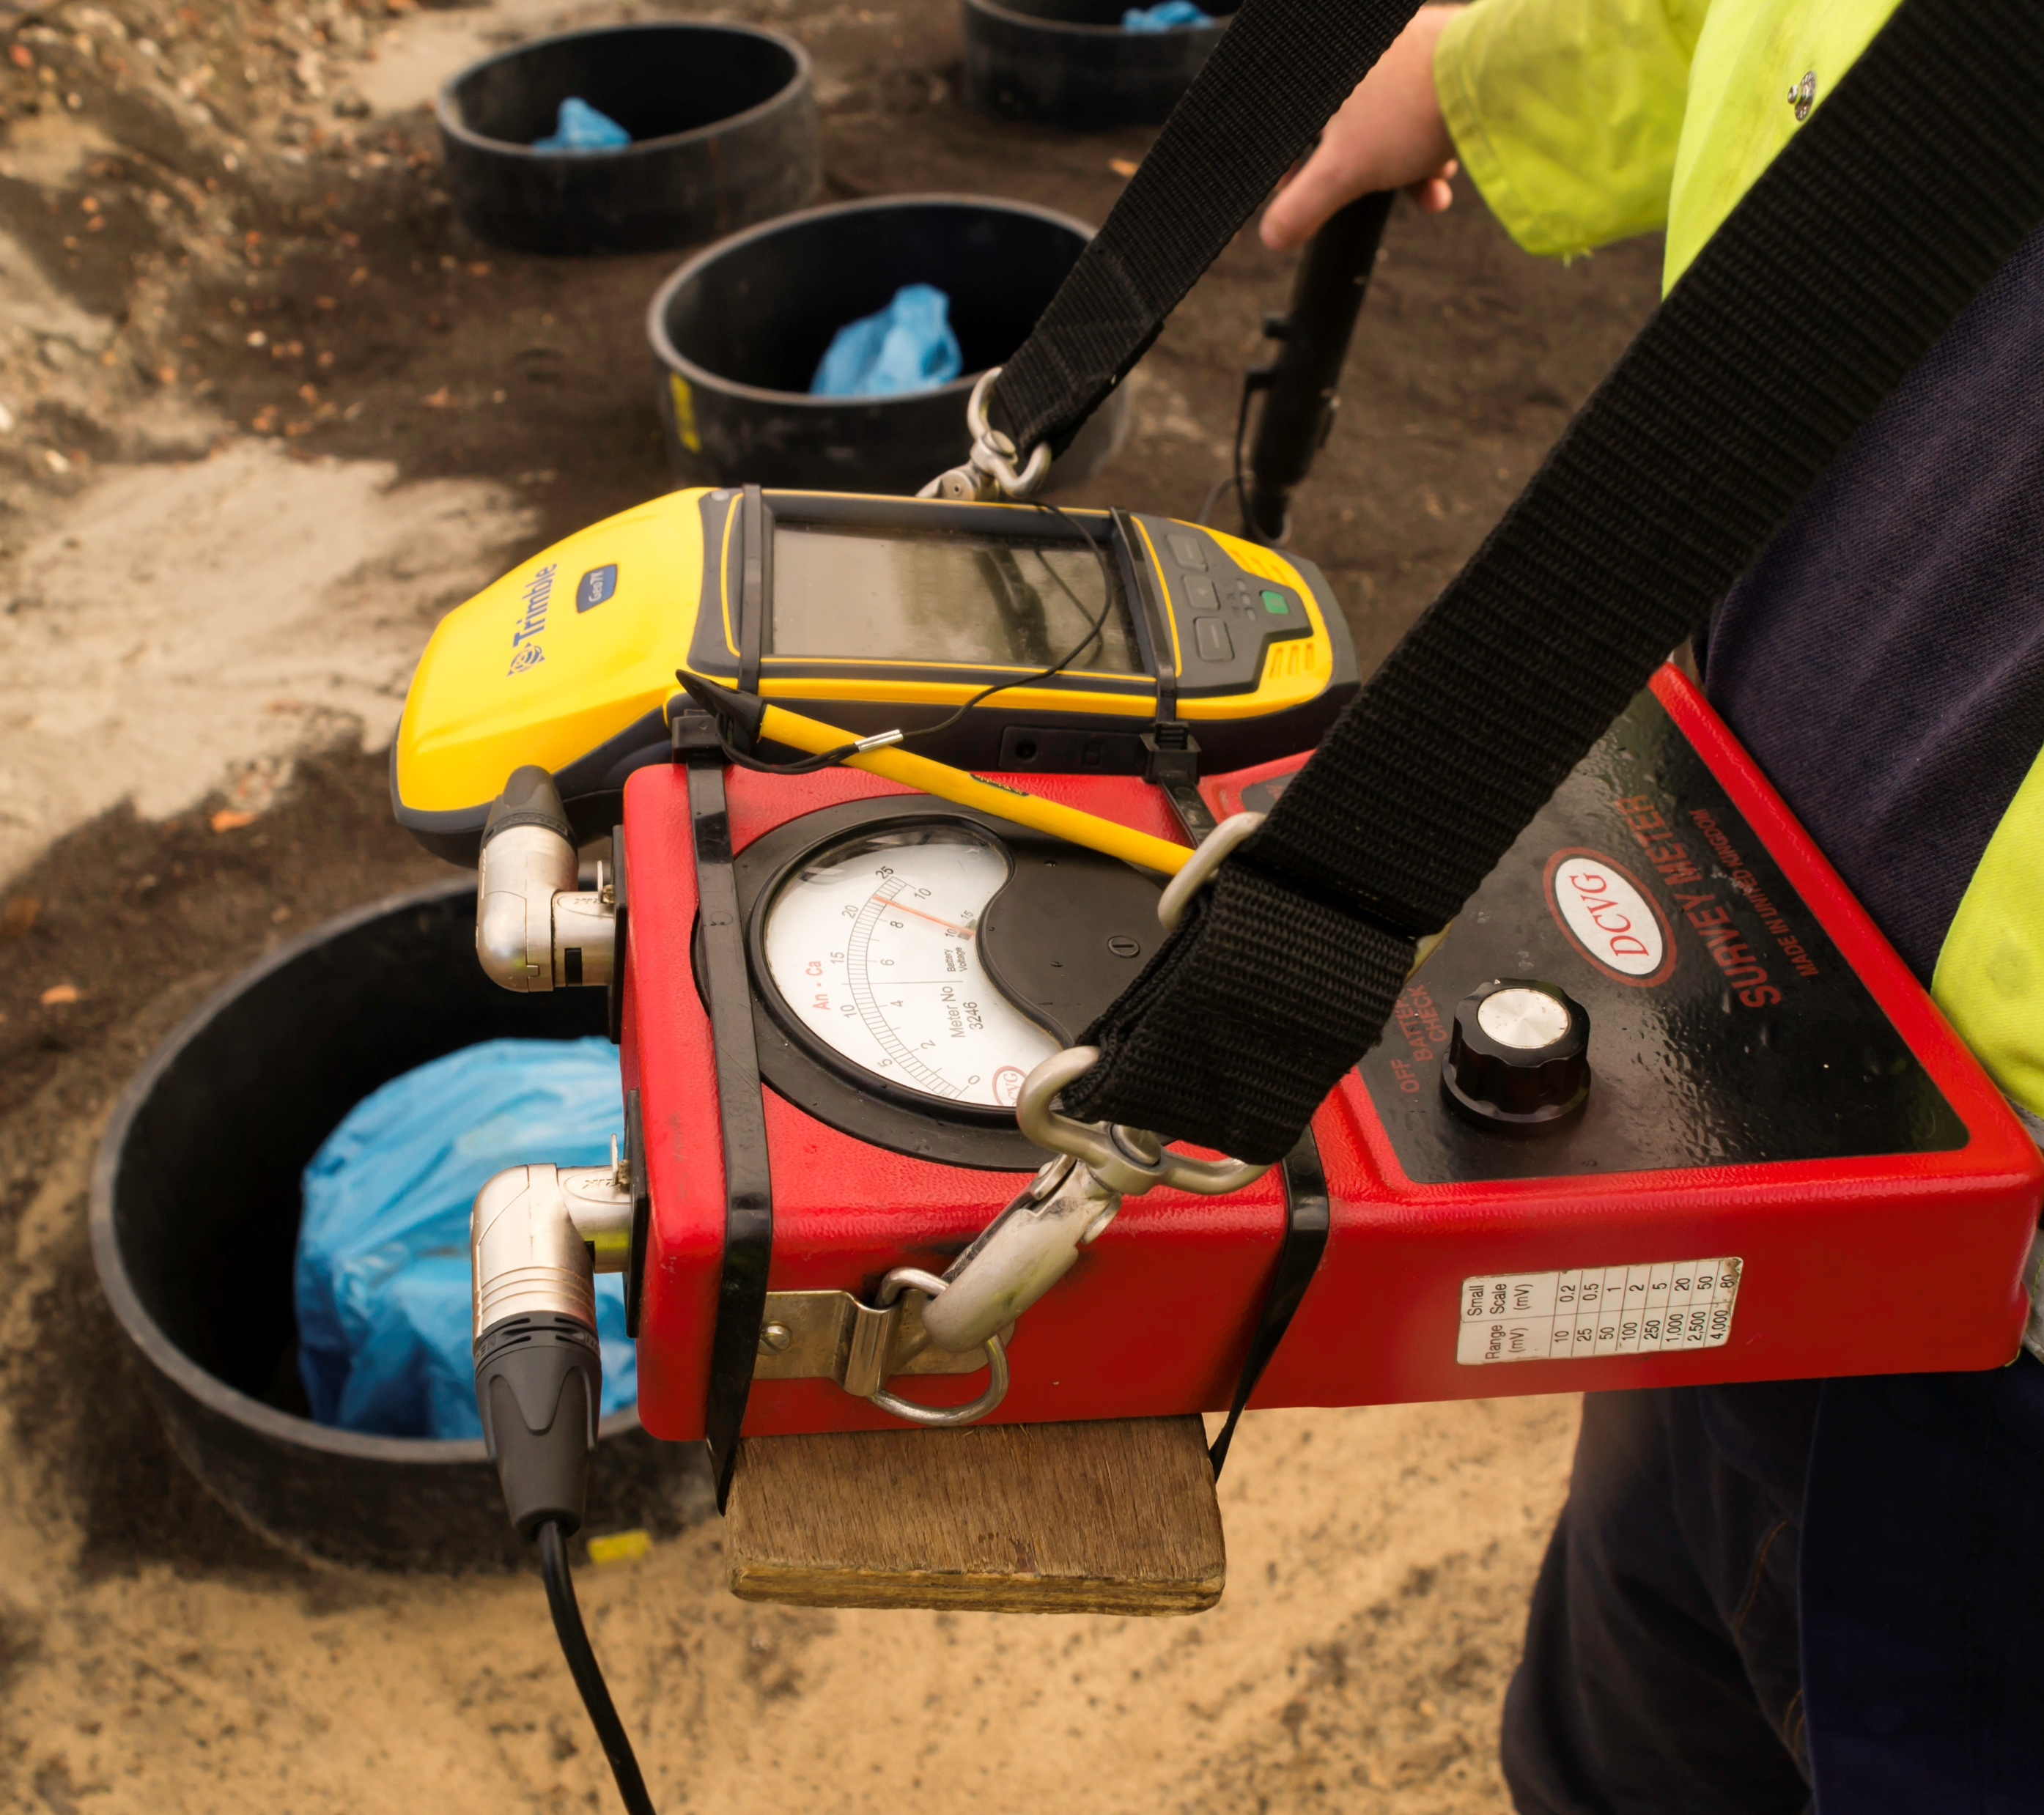
Exhibition Opportunities
  The opportunity to connect with peers, decision-makers and industry innovators. A unique chance to connect with professionals, decision-makers, and innovators in the field.
  The exhibition area is smartly designed - all attendees gather here during breaks and lunches, ensuring maximum interaction.In short: visibility, networking, and new opportunities - all in one!

Slide 18
Exhibitor Package
Company logo with link to your website on the event website
Exhibition space: 1 table, 2 chairs
Free inclusion of brochure in the event shopper
Free inclusion of marketing materials in the event shopper
One conference admission ticket (excluding overnight stay)
€ 2.200

Slide 19
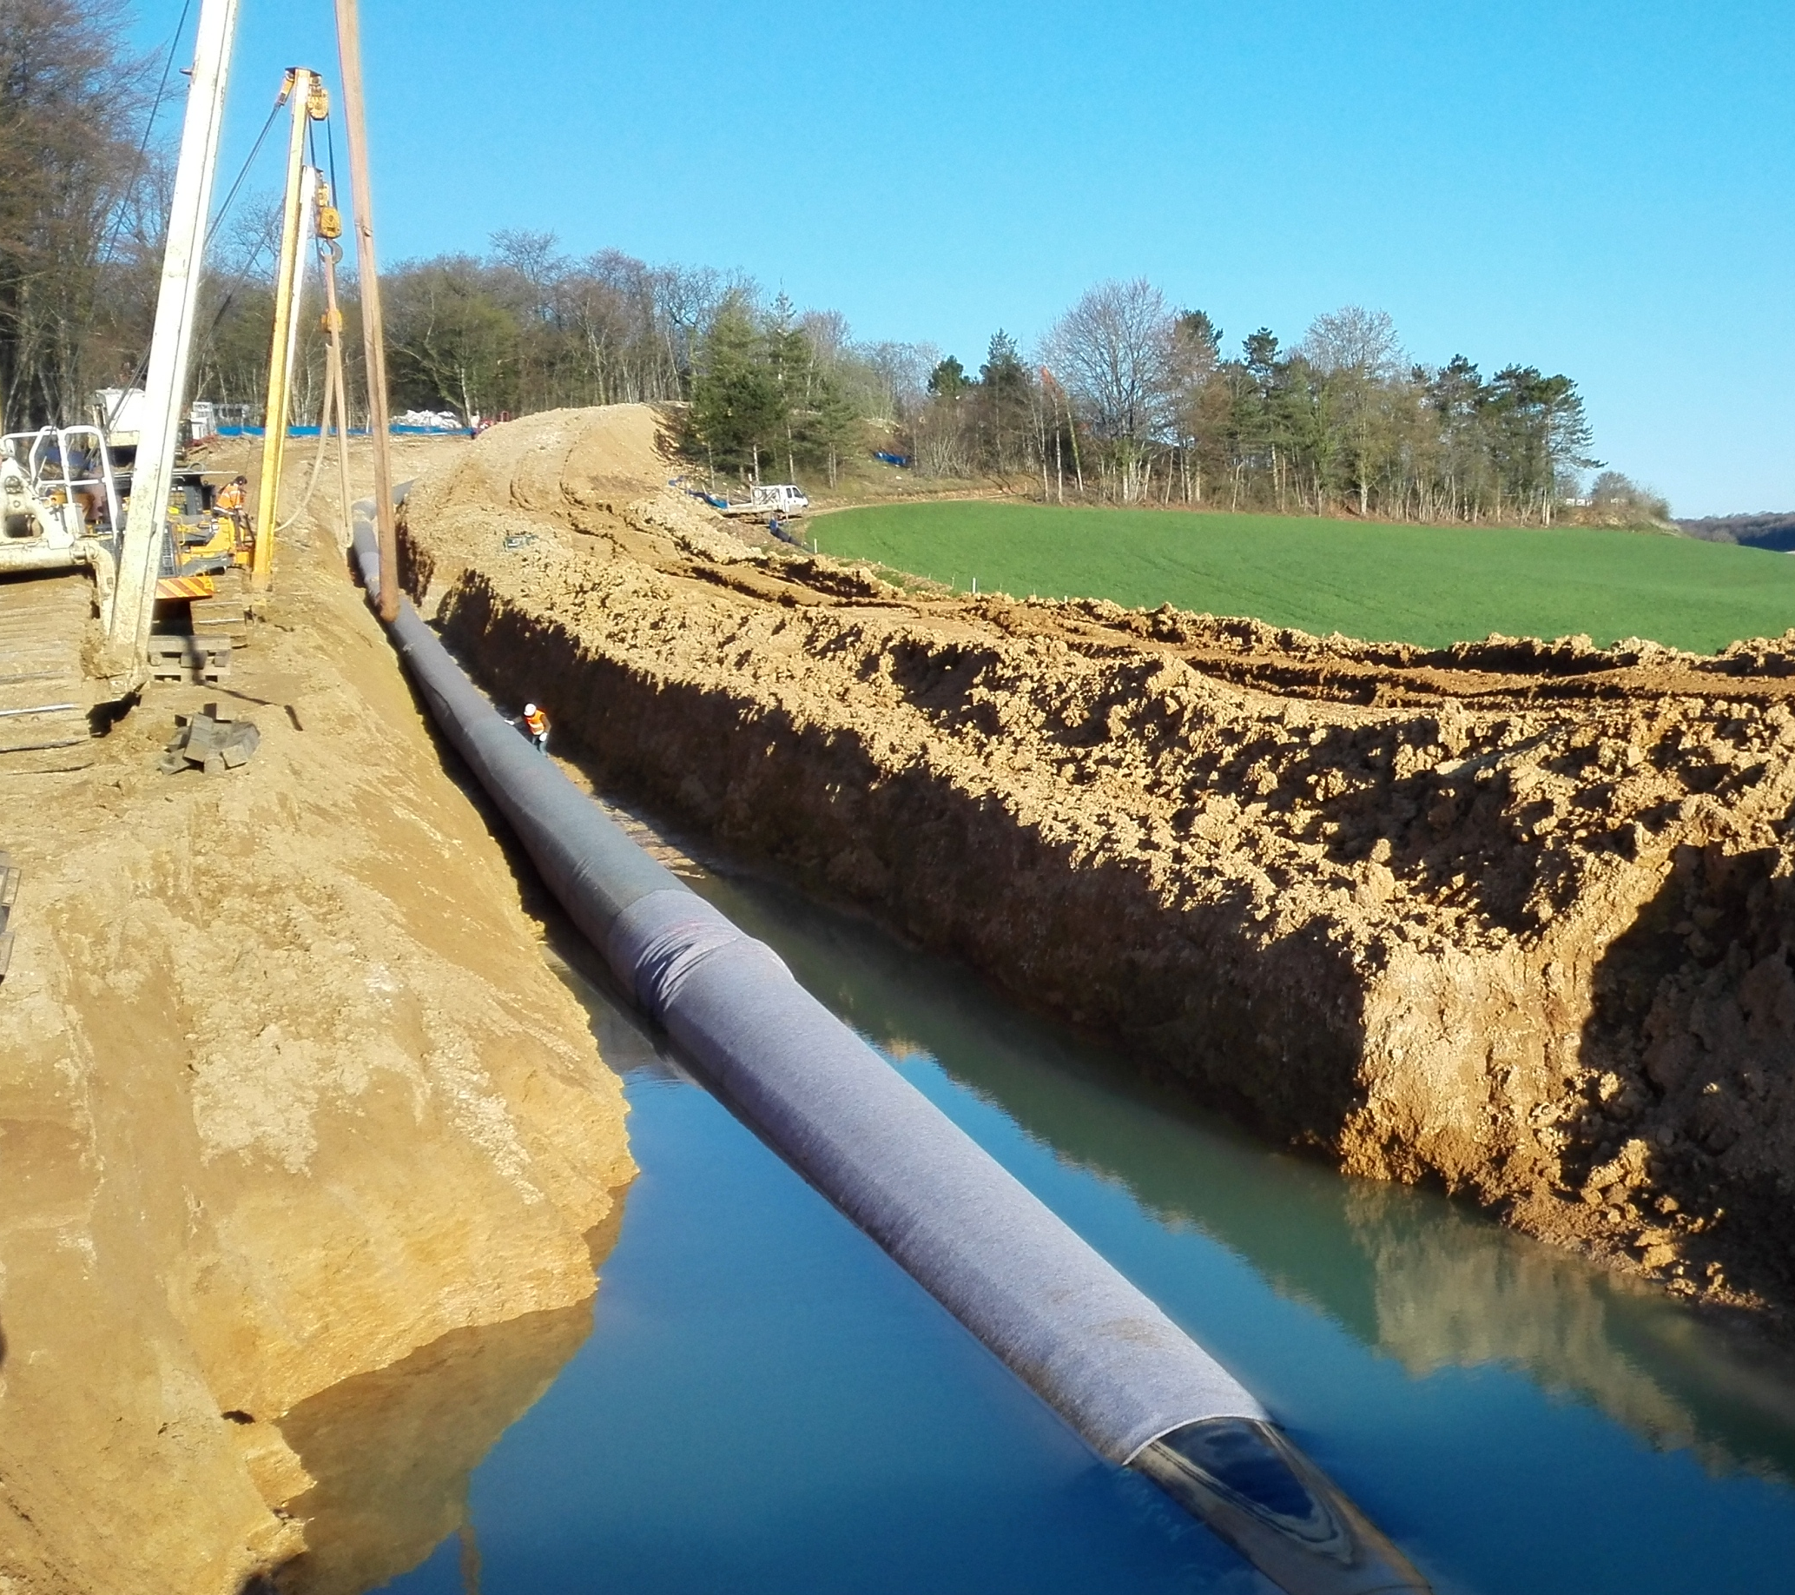
Roll up Banner Package
Company logo with link to your website on the event website
One banner in the conference hall or exhibition area
Free inclusion of brochure in the event shopper
Free inclusion of marketing materials in the event shopper
€ 750

Slide 20
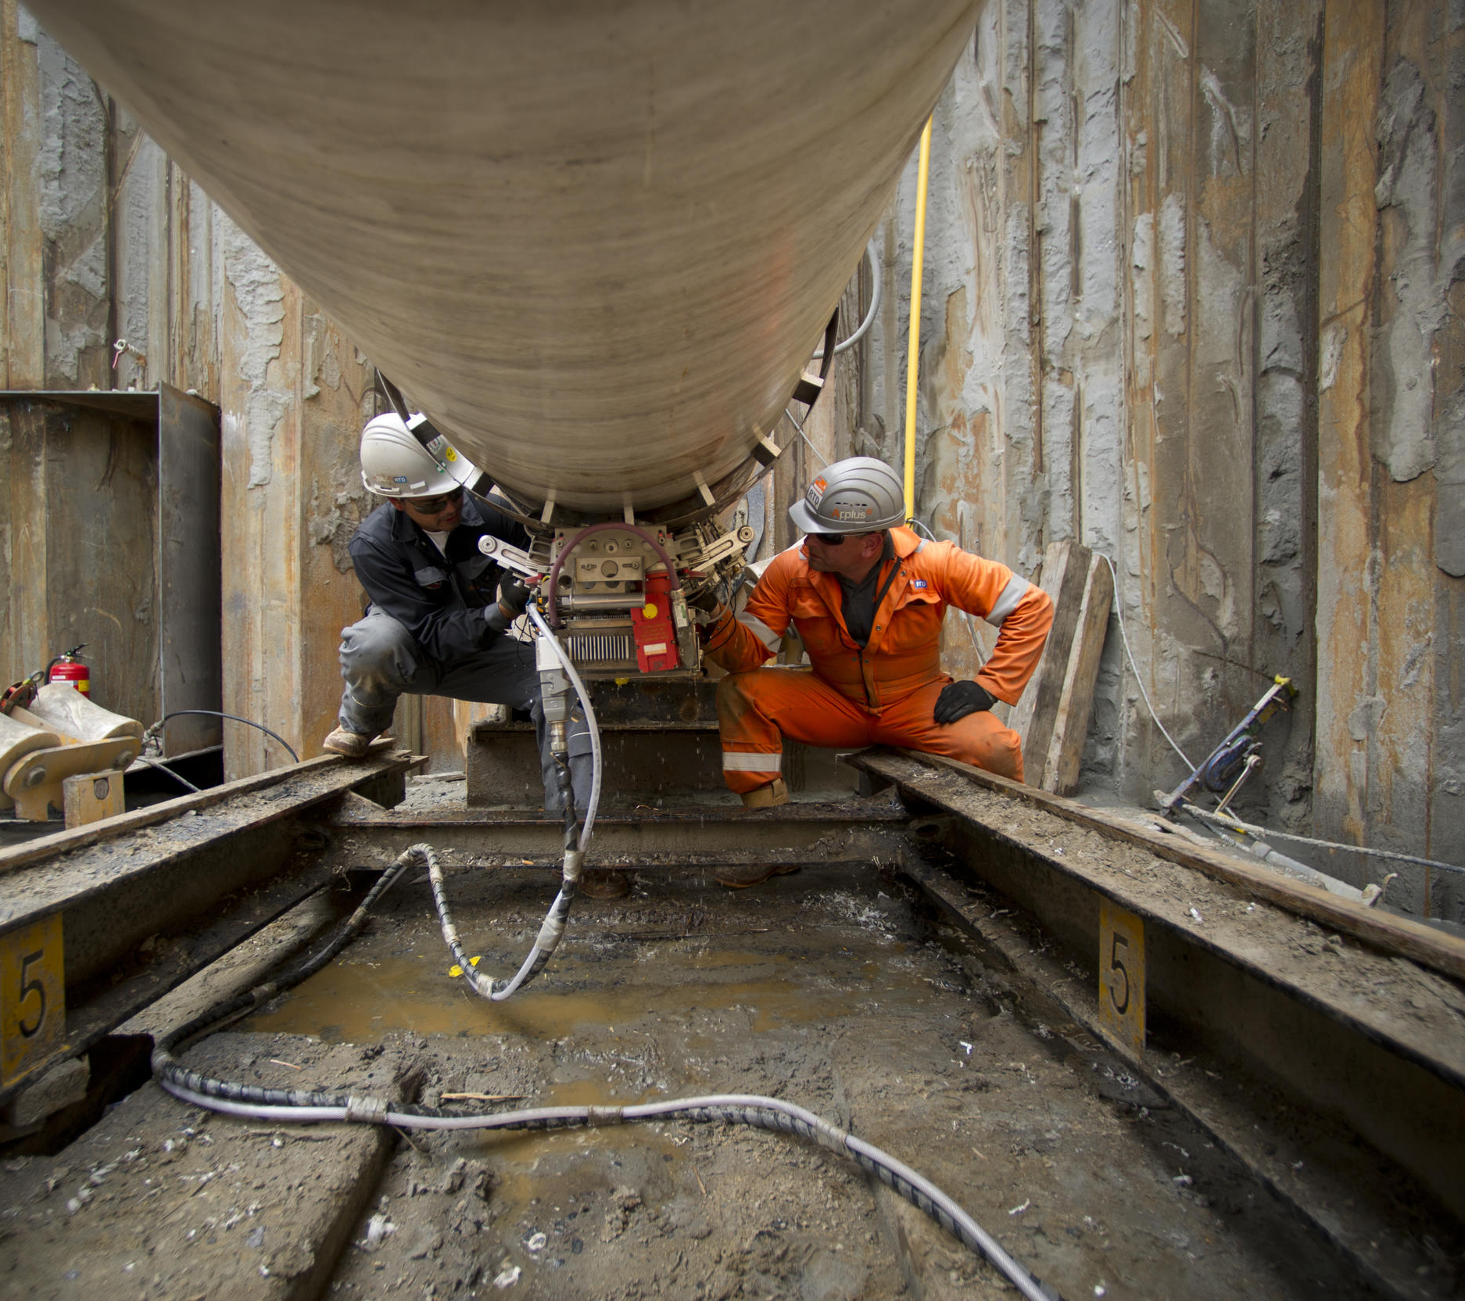
General Sponsorship
Package
Company logo with link to your website on the event website
Free inclusion of brochure in the event shopper
Free inclusion of marketing materials in the event shopper
€ 500

Slide 21
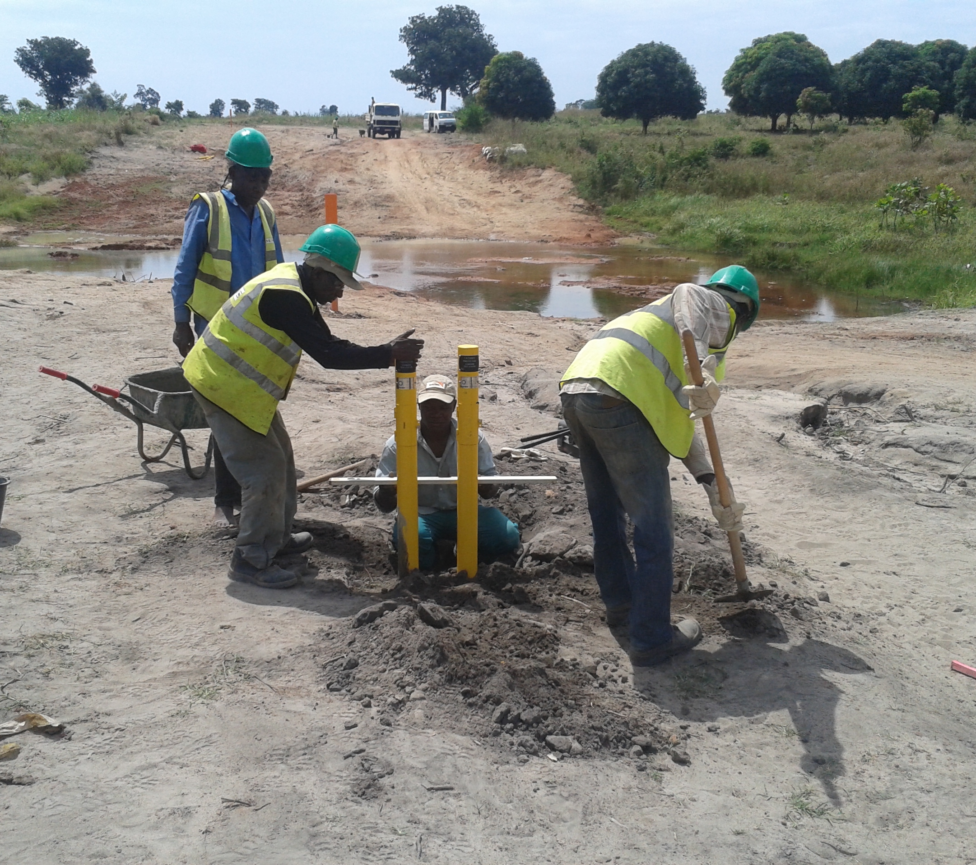

Lanyard Sponsorship
Package
Company logo with link to your website on the event website
Free inclusion of brochure in the event shopper
Free inclusion of marketing material in the event shopper
€ 600

Slide 22
More information
Interested in one of the sponsorship or exhibitor packages?
Please contact
Gonda Boringa
ceocor-2026@vanderheide.nl
0031 - 6 83 18 36 57
All marketing materials are subject to approval by the organizer

Slide 23
Important Information
Material submission deadline: May 4, 2026
Sponsorship and exhibition packages are limited and allocated on first-come, first-served basis.
Delivery of marketing materials at the organizer’s location is at the sponsor’s expense
Exhibition setop: Tuesday, June 2, 2026 (08.00 – 12.00)
Exhibition breakdown: Friday, June 5, 2026 (08.00 – 12.00)
All marketing materials are subject to approval by the event organizer.

Slide 24
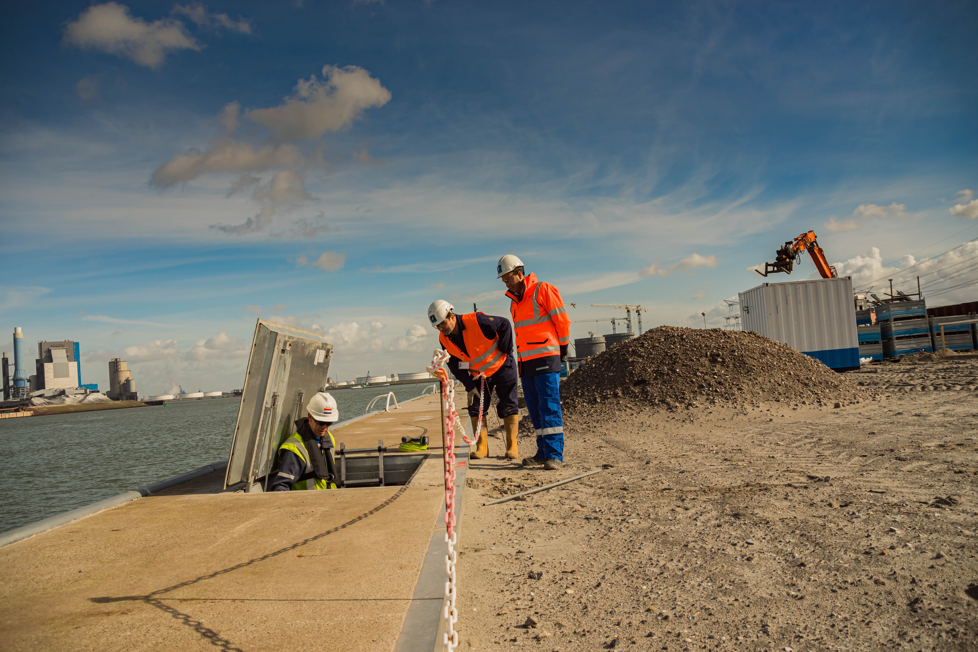
Your world
safer every day

